Slide 1
Access Denied
Keeping yourself off an attacker’s radar
Paul Gilzow gilzow@missouri.edu Twitter: @gilzow Facebook: /gilzow https://www.linkedin.com/in/gilzow
Notes:
How many manage people who admin/maintain wordpress sites?
How many directly admin wordpress sites?
How many are familiar with OWASP top 10?
How many use Apache? Nginx?

Slide 2
a little about me
With the University of Missouri since 2000
Programmer/Analyst since 2005
Maintainer and current author of the wpDirAuth plugin
Notes:
Team lead of 3 programmers managing 100+ WordPress sites
show what information wordpress freely gives away about itself
show how easy it can be to take control of a WordPress site
Everything we’ll cover is widely available on the Internet, and easily findable
Important to remember that we learn today might not be relevant a year from now

Slide 3
who i’m not
Security Expert
Professional Hacker
Notes:
show what information wordpress freely gives away about itself
show how easy it can be to take control of a WordPress site
Everything we’ll cover is widely available on the Internet, and easily findable
Important to remember that we learn today might not be relevant a year from now

Slide 4
What we will talk about
The different types of attacks
Why WordPress is an attractive target
Why Education is an attractive target
Current state of web application security
Tools available
WPScan
Counter-measures
Notes:
The different types of attacks
Why WordPress is an attractive target
Why Education is an attractive target
Current state of web application security
Tools available
WPScan
Counter-measures
One layer, defense-in-depth

Slide 5
Types of Attacks
Opportunistic
Targeted
Notes:
opportunistic not targeting you, just low hanging fruit
opportunistic noisier
targeted stealthy

Slide 6
Why wordpress is an attractive target
Market share
Open Source
Anyone can create and submit a theme/plugin
Extremely easy to set up and get running, not so easy to secure
Notes:
Market share
Open Source
Anyone can create and submit a theme/plugin
Extremely easy to set up and get running, not so easy to secure
With popularity, comes a price.
Economic return for attacking wordpress.
most compromises occur through insecure or out-dated themes & plugins followed by weak passwords
better about removing vul plugins from repo, still have work to do on verifying fixes

Slide 7
“What makes WordPress so insecure is that it's highly extensible and easy to use; wordpress security issues revolve almost entirely around this extensibility and easyness of use.”
Tony Perez, @perezbox

Slide 8
Why Education is an attractive target
Network bandwidth and availability
Rich in hardware infrastructure
Poor in human resources
Resistant to blacklisting
SEO reputation
Personally Identifiable Information (PII) / Sensitive Personal Information (SPI)
Notes:
Network bandwidth and availability
Rich in hardware infrastructure
Poor in human resources
Resistant to blacklisting
SEO reputation
Personally Identifiable Information (PII) / Sensitive Personal Information (SPI)

Slide 9
Current State of Web Application security
Education, 49% of sites had at least one vulnerability every day of the year²
Education, average of 28 vulnerabilities per site, 15 of those serious²
Education, took an average of 4 months to remediate issues²
1 - Google Transparency Report, 2016 2 - White Hat Security Web Applications Security Statistics Report 2016 3 - Sucuri Websites Hacked Report Q1 2016
Notes:
From 2015-2016 160% increase in sites hosting malware1
Education, 49% of sites had at least one vulnerability every day of the year2
Education, average of 28 vulnerabilities per site, 15 of those serious2
Education, took an average of 133 days to remediate issues2
78% of compromised sites that were in a CMS were using WordPress3
2 biggest issues in website/web application security is education and awareness. Gone are the days of web MASTERS.
High-Tech Bridge (Geneva) found that 35% of sites that contained an XSS issue, also contained other, more serious issues
As an owner/maintainer of a wordpress site, it is your responsibility to be paranoid

Slide 10
current state of wordpress security
Most compromises occur through
vulnerable plugins and themes
Weak passwords
Wordpress out-of-date
Vulnerability categories
Injections
Remote File Inclusion and/or Execution
Brute force and/or dictionary attacks
Notes:
Most compromises occur through
vulnerable plugins and themes
Weak passwords
Wordpress out-of-date
Vulnerability categories
Injections
Remote File Inclusion and/or Execution
Brute force and/or dictionary attacks
SQL, XSS, iFrame, etc
TimThumb, RevSlider
Ability to pass commands to a payload on your server and bypass your security
Exploit publicly-available access points

Slide 11
Available Tools
BuiltWith.com
Wappalyzer (Firefox, Chrome, Opera + bookmarklet)
CMSmap : https://github.com/dionach/CMSmap
Droopescan : https://github.com/droope/droopescan
WPScan : http://wpscan.org/
Notes:
BuiltWith.com
Wappalyzer (Firefox, Chrome, Opera + bookmarklet)
CMSmap : https://github.com/dionach/CMSmap
Droopescan : https://github.com/droope/droopescan
WPScan : http://wpscan.org/
BEFORE YOU GO TO THE NEXT SLIDE, scan wpcampus.org

Slide 12
WPScan
Passive Scan
Robots.txt
Interesting headers
Multisite
Must-use plugins
Xml-rpc
Wordpress version
Plugins/themes
Notes:
Passive Scan
Robots.txt
Interesting headers
Multisite
Must-use plugins
Xml-rpc
Wordpress version
Plugins/themes
Mention false positive, humans always needed - license.txt on wpcampus.org
log in, show users, themes, plugins THEN LOG OUT!

Slide 13
Counter measures
Disable Directory listings
In .htaccess in the root of the site
ask your host to disable in your account
Options -Indexes

Slide 14
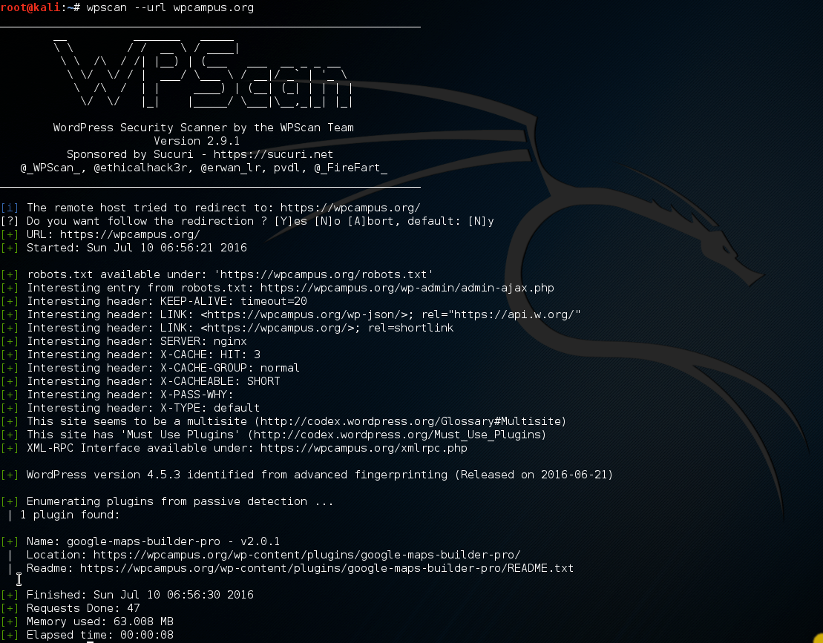

Slide 15
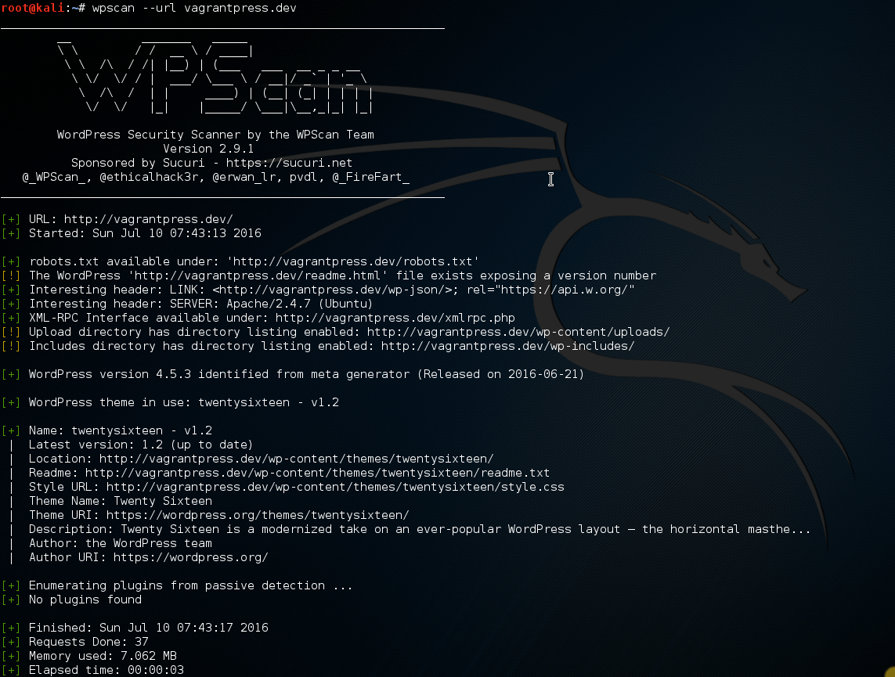

Slide 16
WpScan
Active scan
Scans for signs of vulnerable plugins
Scans for signs of vulnerable themes
Scans for signs of timthumb
Attempts to enumerate user account names
Notes:
Active scan
Scans for signs of vulnerable plugins
Scans for signs of vulnerable themes
Scans for signs of timthumb
Attempts to enumerate user account names

Slide 17

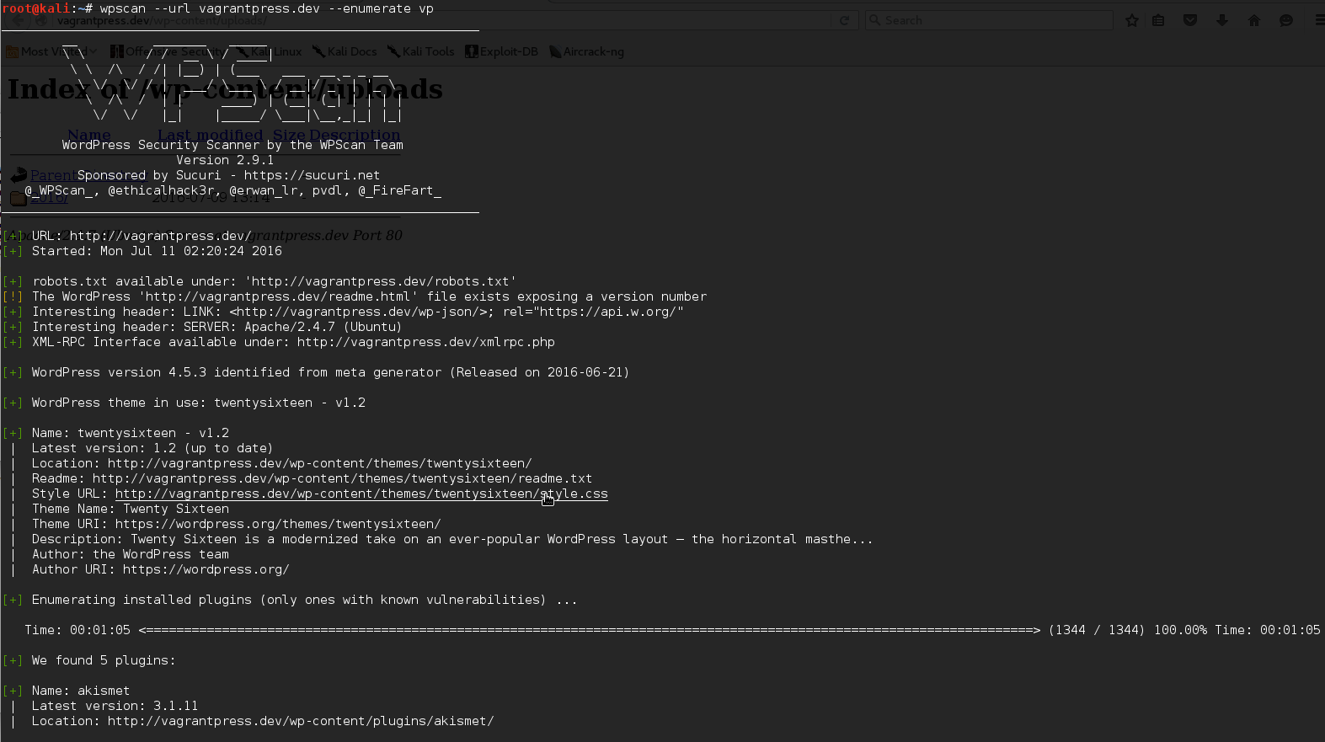


Slide 18
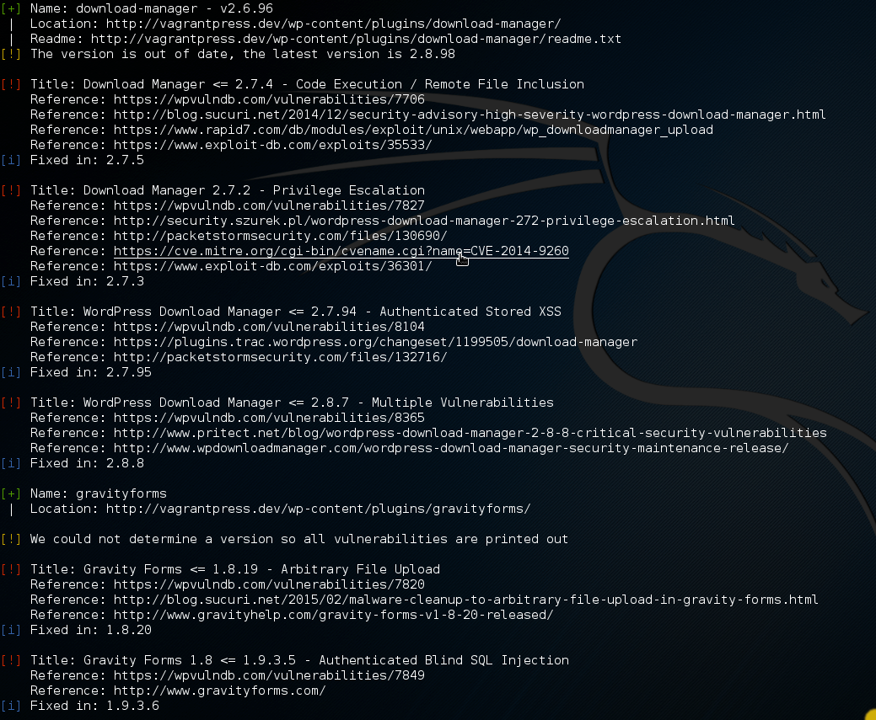
Notes:
CVE - Common Vulnerabilities and Exposures

Slide 19
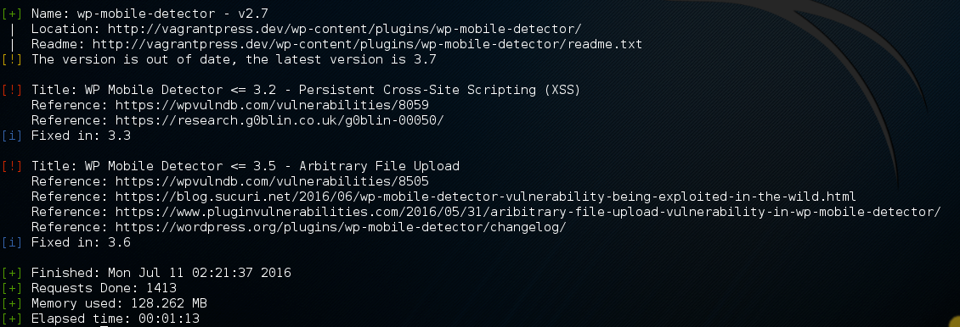

Slide 20
Counter measures
Protect wp-content
Prevent php execution
Implicit deny (only allow what is necessary and expected)
Protect wp-includes
Protect wp-admin
Notes:
Protect wp-content
Prevent php execution
Implicit deny (only allow what is necessary and expected)
Protect wp-includes
Protect wp-admin
run exploit after showing initial active scan on vagrantpress.dev
do wp-content area first, only blocking php
show how shell wouldn't be accessible, rerun scan
next do blocking of everything except white-list, show how everything is blocked but DONT do scan
Add errordocument reroute THEN do scan

Slide 21
Counter measures
Account enumeration
Prevent ?author= redirection
Disable account name as author permalink
Remove author account from classes
Remove default login failure error messages
Notes:
Prevent ?author= redirection
Disable account name as author permalink
Remove author account from classes
Remove default login failure error messages
Debate on whether account enumeration prevention is important
Even more important is strong passwords for every account
Block brute force attempts and mention xmlrpc
also mention that it’s possible for people to log in using email address and email addresses are EVERYWHERE, especially in education
Mention using school’s SSOID system

Slide 22
additional Counter measures
Limit access to wp-login.php and /wp-admin/
Limit or disable xmlrpc
Disable file editing
Lock down wp-config.php
Hide wordpress version
if(!defined('DISALLOW_FILE_EDIT')){
define('DISALLOW_FILE_EDIT', TRUE);
}
Notes:
xmlrpc
- ddos attacks
- bruteforce
directories
find /path/to/your/wordpress/install/ -type d -exec chmod 755 {} \;
files
find /path/to/your/wordpress/install/ -type f -exec chmod 644 {} \;

Slide 23
More extreme Counter measures
Use suPHP, php-fpm
Prevent php from being able to write to files
Move wp-config.php
Move plugin and theme locations
Programmatically changing user_nicename
Notes:
xmlrpc
- ddos attacks
- bruteforce
directories
find /path/to/your/wordpress/install/ -type d -exec chmod 755 {} \;
files
find /path/to/your/wordpress/install/ -type f -exec chmod 644 {} \;

Slide 24
additional things to consider
Log everything and analyze those logs

Slide 25
Counter measures
Make sure you have directory listing disabled
Prevent PHP execution where it shouldn’t happen
User account names
XML-RPC

Slide 26
Summary
Be paranoid; be skeptical
Uninstall plugins/themes that aren’t in use
Disable php from executing where it shouldn’t
Limit access to everything where you can

Slide 27
“[Security is a] continuously moving target… that requires constant vigilance to understand and appreciate.”
Tony Perez, @perezbox
Notes:
what we cover/discuss today might not be relevant next year

Slide 28
With ease of use and extensibility, comes a responsibility.
Tony Perez, @perezbox

Slide 29
questions?
Contact
gilzow@missouri.edu
@gilzow on twitter
Files: https://github.com/gilzow/access-denied/

